Slide 1
TEAM GENESIS WEB REQUEST LIFECYCLE -by yoga 02 March 2022

Slide 2
Imagine you’re writing to a penpal. The process would look something like this:
Write a letter
Specify your penpal’s address
Drop the letter in your mailbox
The letter goes through the postal system and arrives at your penpal’s mailbox
Your penpal then goes through a very similar set of steps:
Read your letter and write a response
Specify your address
Drop their letter in their mailbox
The letter goes through the postal system and arrives at your mailbox

Slide 3
You are the Client​
Your penpal is the Server​
Your letter is the Request​
Your penpal’s letter is the Response​
The postal system, the thing responsible for ensuring your letters are delivered, is The Internet​

Slide 4
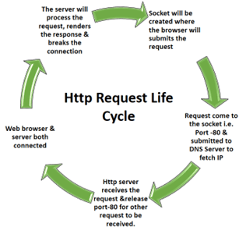

Slide 5


